Slide 1
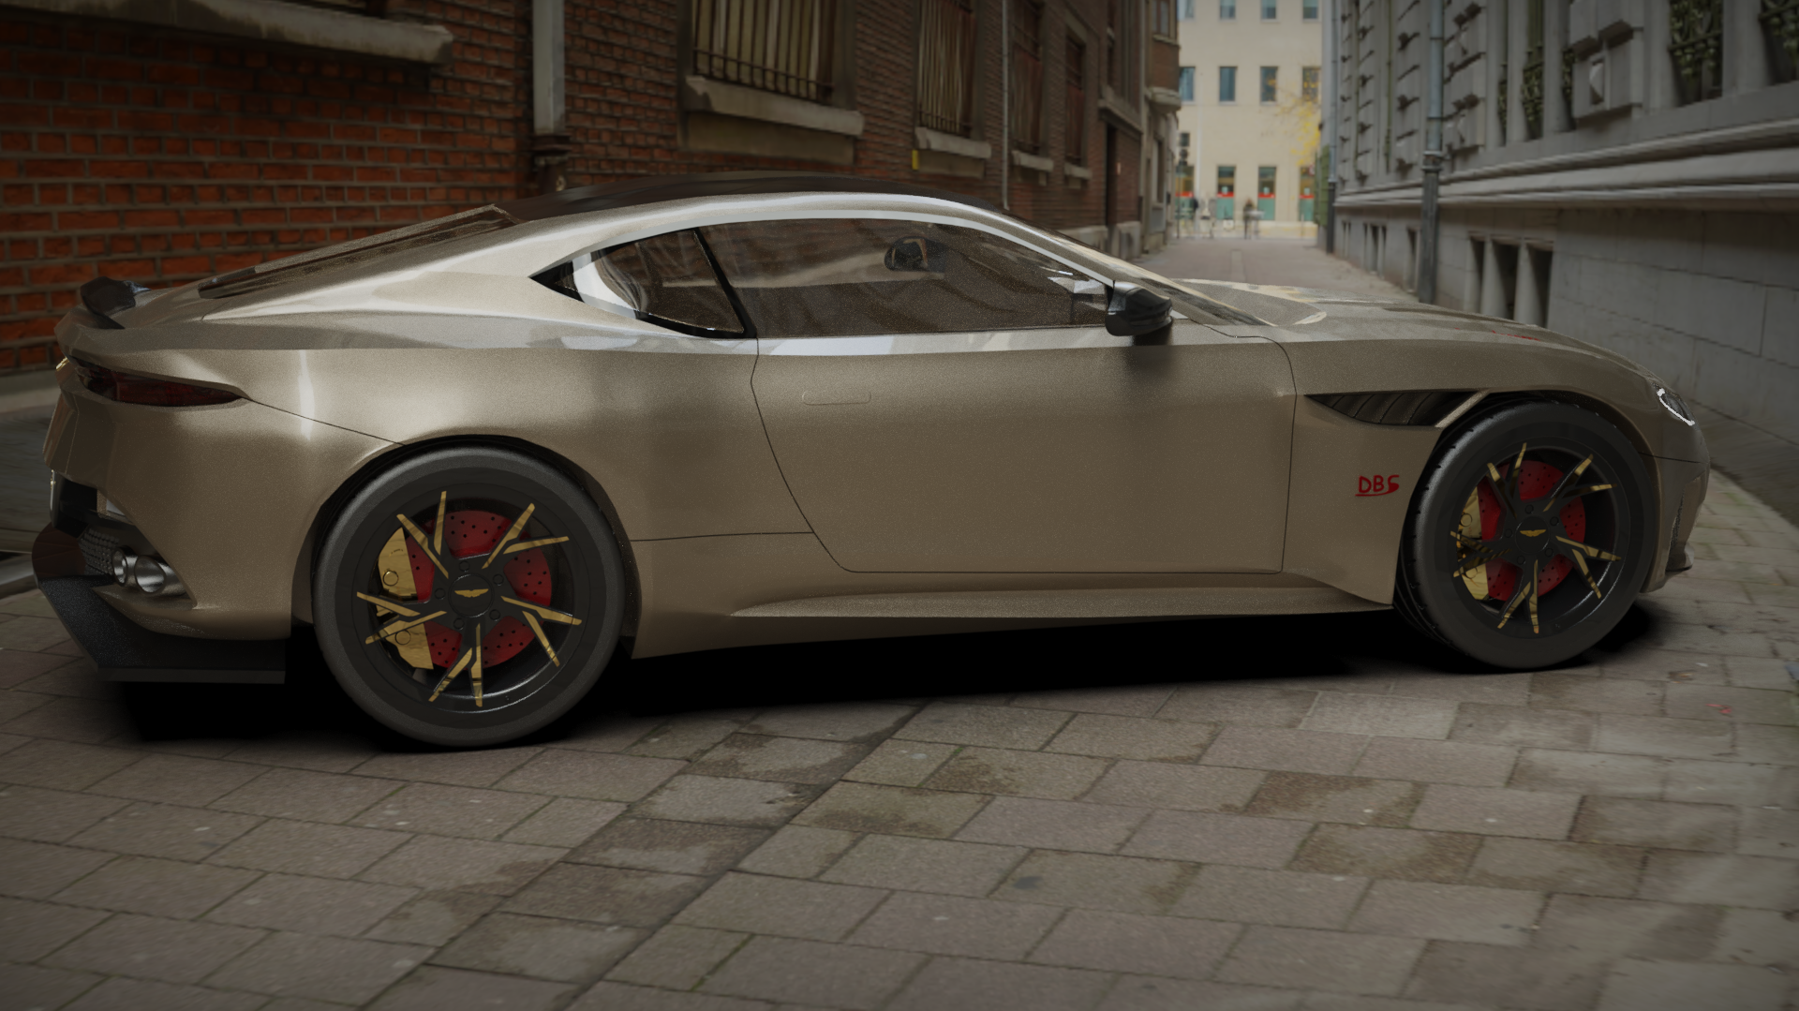
Master your Skills with Fusion 360 for aspiring Engineer
This presentation outlines a comprehensive plan for teaching 3D design, focusing on the powerful and versatile software Fusion 360. We'll explore the different types of 3D software, the design process, and the importance of learning 3D design in today's world. We'll also delve into the specifics of Fusion 360, its features, and how to get started with this industry-standard tool with extra such as rendering and animation.

Slide 2
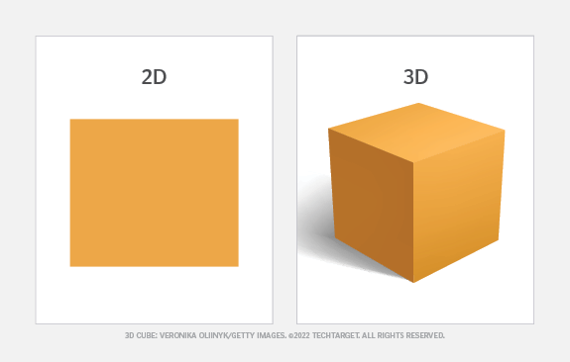
Introduction to 3D Design
1
Definition
2
Brief History
3
Applications
3D design is the process of creating three-dimensional models of objects, environments, or characters using specialized software.
From early computer graphics to modern CGI (Computer-Generated Imagery), 3D design has evolved significantly, revolutionizing various industries.
3D design has numerous applications, including film and animation, gaming, architecture and engineering, product design and manufacturing, and aerospace and automotive industries.

Slide 3



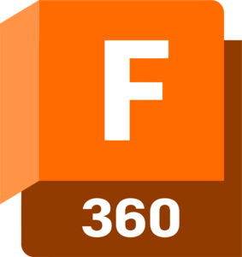

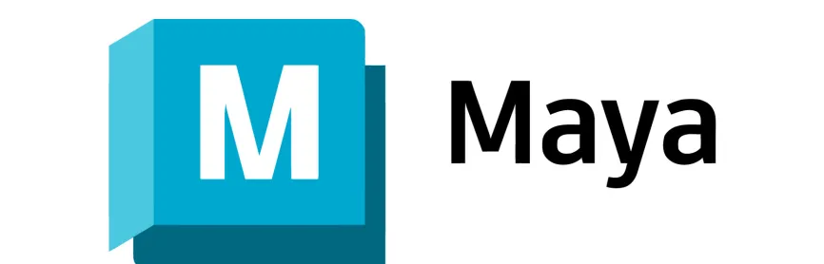

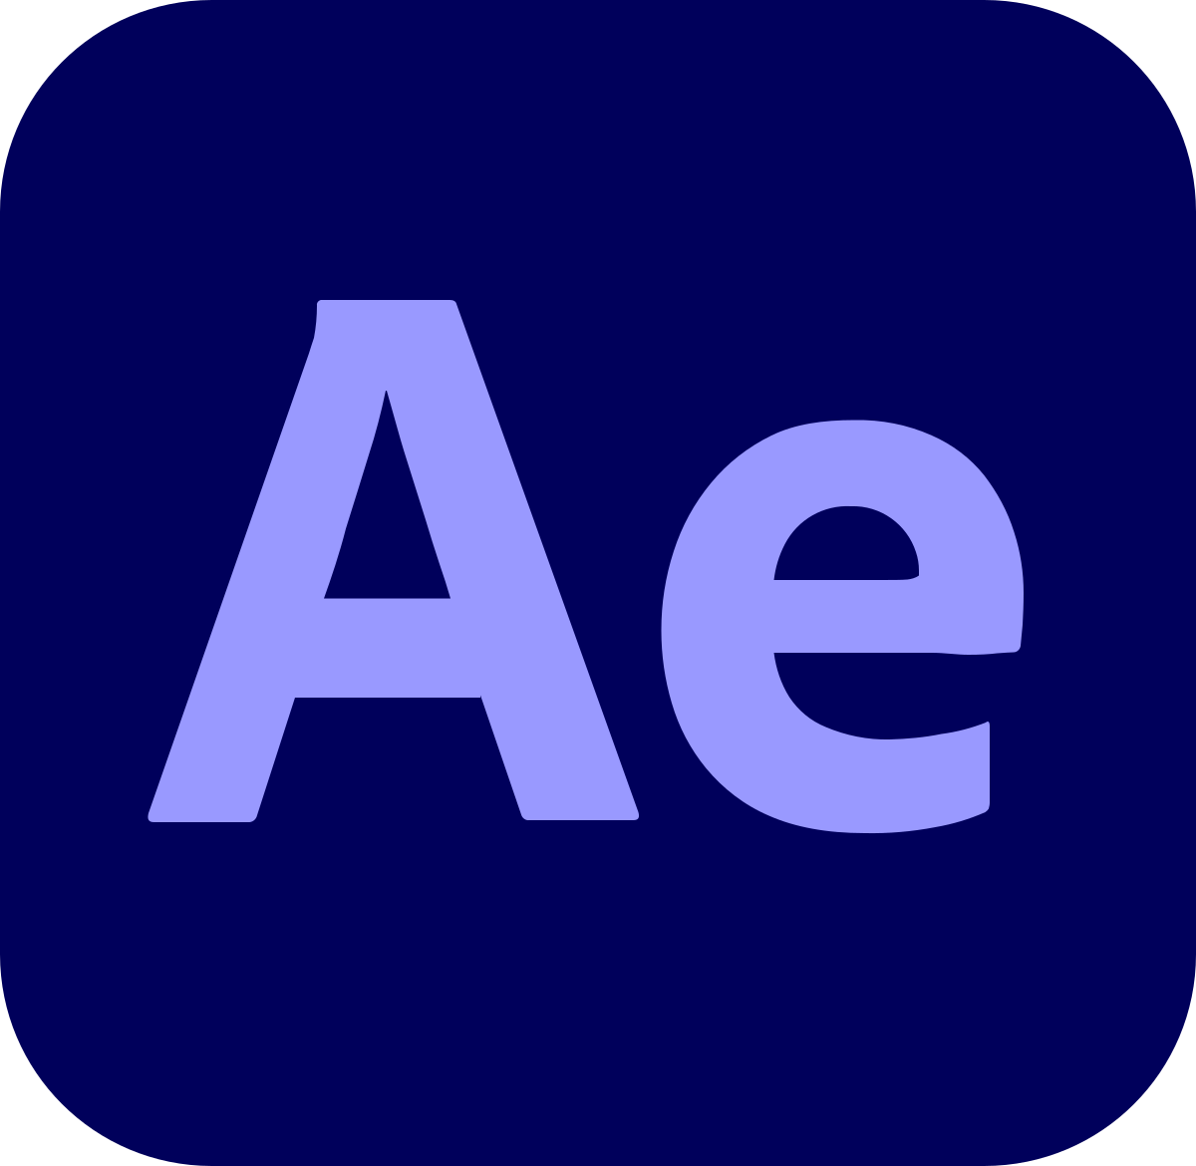



Introduction to Different Types of 3D Software
CAD Software
Sculpting Software
Motion Graphics Software
CAD (Computer-Aided Design) software is primarily used for designing mechanical parts, industrial products, and precise engineering models. It's ideal for creating technical designs with strict dimensional accuracy.
Sculpting software is used to create organic, detailed models, often used in character design, animation, or 3D printing of artistic objects.
Motion graphics software focuses on animation, visual effects (VFX), and dynamic simulations for movies, games, and advertisements.
ZBrush
Cinema 4D
Blender (Sculpt Mode)
Blender
Autodesk Mudbox
Maya
After Effect
Fusion 360
SolidWorks
AutoCAD
Catia
SketchUp

Slide 4



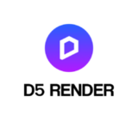



Introduction to Different Types of 3D Software
3D Game Engines
Rendering Software
Game Engine Software are used to create interactive 3D environments and video games, but also used in architectural, VR, and Simulation. They offering real time rendering, scripting and animation
Rendering is the process of creating 2D images or animations from 3D models, using textures, lighting, and camera angles. It’s used in fields like film, architecture, and video games to produce realistic or artistic visuals.
Blender (Free)
Keyshot (Partially Free )
Ureal Engine (Free)
D5 Render (Partially Free)
Lumion (Partially Free
Twinmotion (Free)
Unity
Ureal Engine
Godot
Those are just some examples

Slide 5

Importance of Learning 3D Design
Innovation and Creativity
3D design is a powerful tool for bringing innovative ideas to life, whether for products, films, or industrial applications.
Problem Solving
Engineers and designers use 3D modeling to solve complex problems, simulate real-world conditions, and test solutions virtually.
Career Opportunities
Industries like animation, film, product design, engineering, and aerospace all require skilled 3D designers, creating ample job opportunities.
Prototyping and Manufacturing
3D models can be turned into physical products through 3D printing and CNC machining, speeding up the prototyping process.

Slide 6
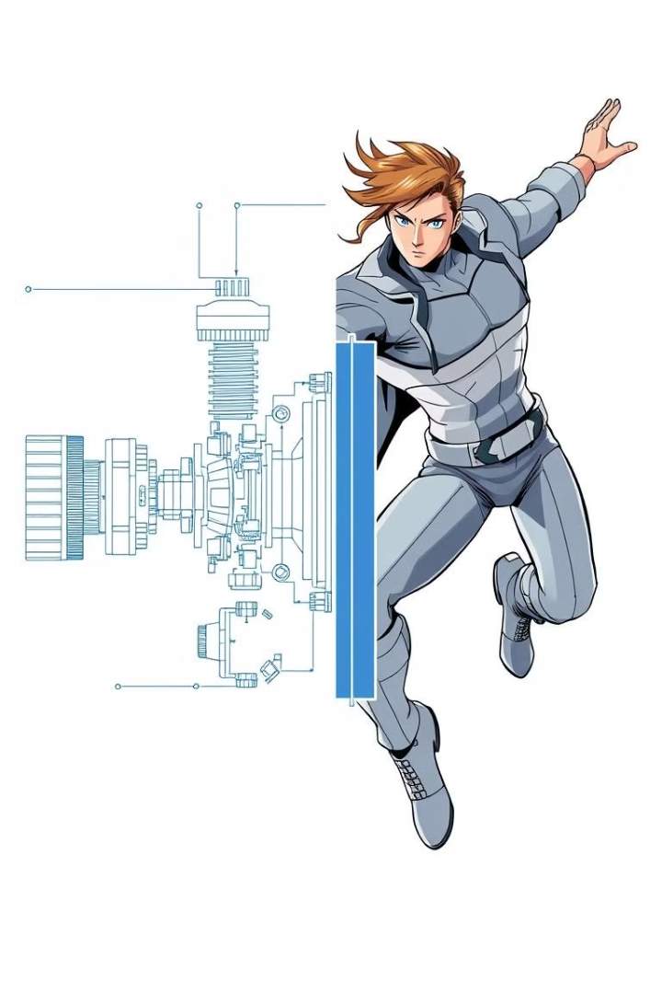
Difference Between CAD Software and Animation Software
CAD Software (Computer-Aided Design )
Animation Software
Focus on precision and technical modeling
Focus on creative modeling, animation, and visual effects
Used in industrial design, engineering, and manufacturing
Used in film, gaming, and animation industries
Supports engineering analysis and simulation
Tools for character rigging, animation, lighting, and rendering
Outputs technical drawings and manufacturing files
Typically outputs rendered images, animations, or game assets

Slide 7
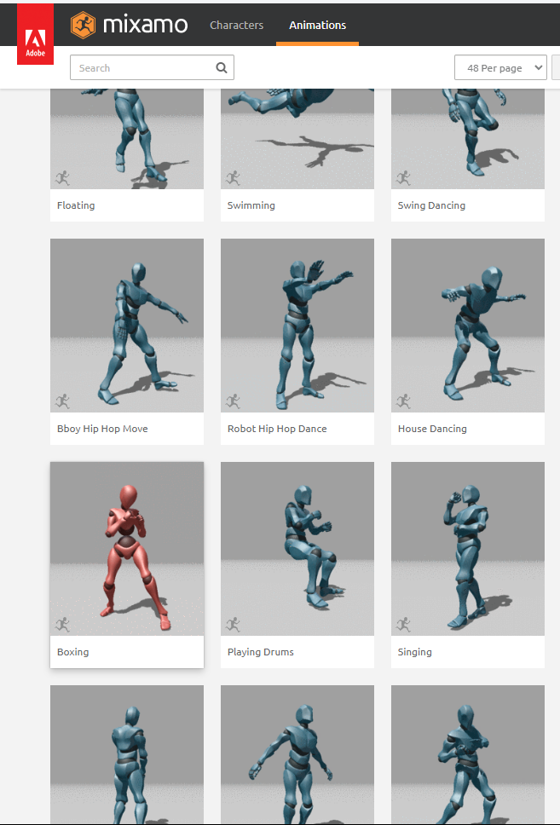
Introduction to 3D Animation
Of course scripting first this is just a global idea.
1
Modeling
Creating 3D models of characters, objects, or environments.
2
Rigging
Adding a skeleton to the model to control movement.
3
Animating
Creating movement by manipulating the rig over time.
4
Rendering
Producing the final animated sequence with lighting and effects.
3D Animation is the process of creating moving images in a three-dimensional digital space

Slide 8







The Design Process: From Concept to Validation
Thinking
Understand the client’s needs or project requirements. Brainstorm potential solutions, sketch concepts, and define the overall approach.
Designing
Create 3D models using Fusion 360 or SolidWorks. This stage involves detailed geometry creation, ensuring the model is accurate and functional.
Testing and Simulation
Use Fusion 360’s simulation tools to perform virtual stress, motion, and thermal analysis to ensure the design works as expected in real-world conditions.
Prototyping
Export the 3D model for rapid prototyping using 3D printing. Fusion 360’s integrated tools allow you to convert your design into a 3D-printable file format.
Rendering
Use Blender, KeyShot, Twinmotion, Ureal Engine to create highly realistic visualizations and animations.
Validation
Produce a final prototype that has passed all testing phases. Present the finished model and renderings/animations to the client.
Manufacturing / 3D printing
Once validated, the design can be sent for mass production, using CNC (Computer Numerical Control) machines, molds, or other manufacturing methods or even 3D printing.

Slide 9
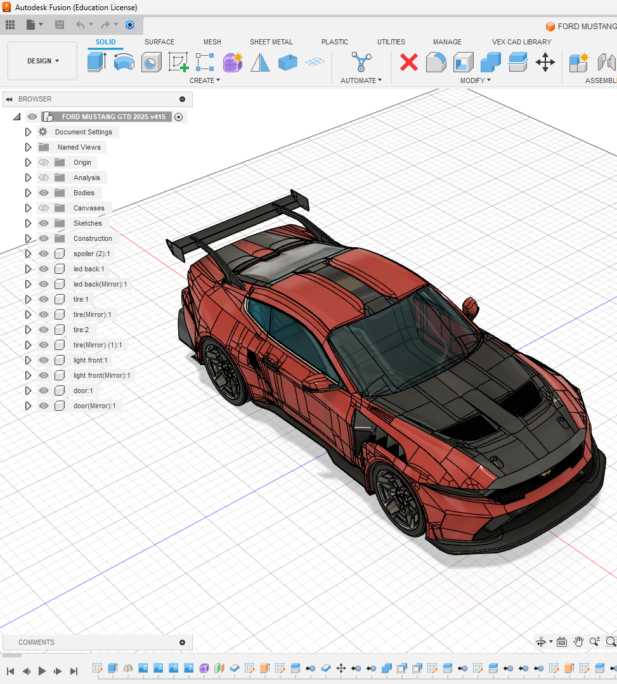




Focus on Fusion 360
Overview
Fusion 360 is an integrated cloud-based CAD, CAM, and CAE tool developed by Autodesk. It is used for product design, 3D modeling, simulation, and manufacturing.
Key Features
Fusion 360 offers a wide range of features, including 3D modeling, simulation and analysis, manufacturing, and collaboration.
Why Use Fusion 360?
Fusion 360 is widely used in the product design, engineering, and manufacturing sectors, making it essential for students aiming for careers in these fields.
Getting Started with Fusion 360
Begin by familiarizing yourself with the user interface, basic commands and tools, and then try a simple part design to get a feel for the software.

Slide 10
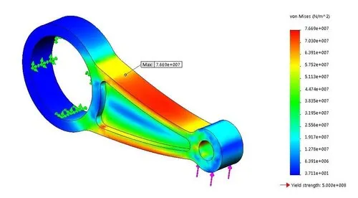
Advanced Fusion 360 Features
1
Parametric Design
Create models that automatically update when dimensions change, ensuring consistency and efficiency.
2
CAM (Computer-Aided Manufacturing),Simulation,Simple Animation
Generate tool paths and G-code for CNC machining, enabling the creation of physical prototypes., simulate with CFA, animate your 3D model
3
3D Printing
Export models in formats suitable for 3D printing (STL files), allowing for rapid prototyping.
4
Electrical circuit design
Fusion 360 offering possibility to design PCB using eagle combine to 3D interactive viewer

Slide 11
Our Workflow for Rendering
Import into FBX
3D modeling
Assembly
Texturing (color)
Advance Animation
Lighting
Rendering
3D modeling
Assembly
Basic color
Exporting into FBX format
Technical Drawing

Slide 12

Our Workflow 3D Printing
Import into STL
Choose 3D printer
Setting Optimization
Export into GCODE
3D modeling
Assembly
Technical Drawing
Export to STL

Slide 13
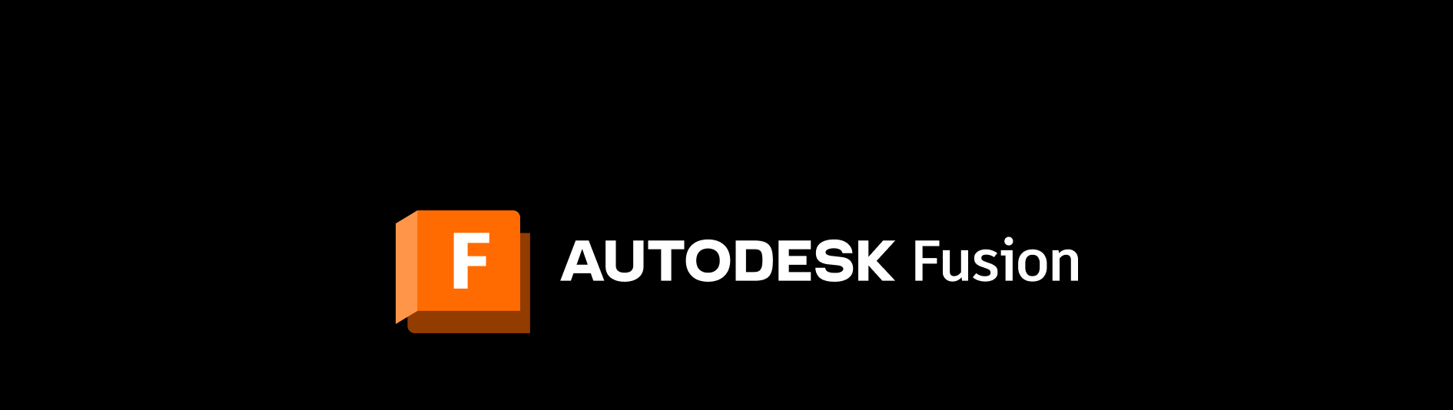
Conclusion and Future Learning Path
Fusion 360 is a powerful tool that can be used to create a wide range of 3D designs. By learning Fusion 360, you'll gain valuable skills that are in high demand in various industries. As you continue your learning journey, explore specializations in product design, simulation, or manufacturing, and consider pursuing career opportunities in engineering, product development, manufacturing, or freelance design work but Fusion it’s not the only software we will learn.

